Slide 1

OFFLINE JUDGE
Just SOLVE it

Slide 2
Overview
Offline judge is a offline software dedicated to competitive programming. It can be a tool for practicing offline without any worry of internet connection , specially in remote area.

Slide 3
Features
Register & Login Form
Create User Account
View Problems
Submit Solutions
Submission List
Ranking for Local Database
Update info
And Progress
Update Info
View Profile

Slide 4
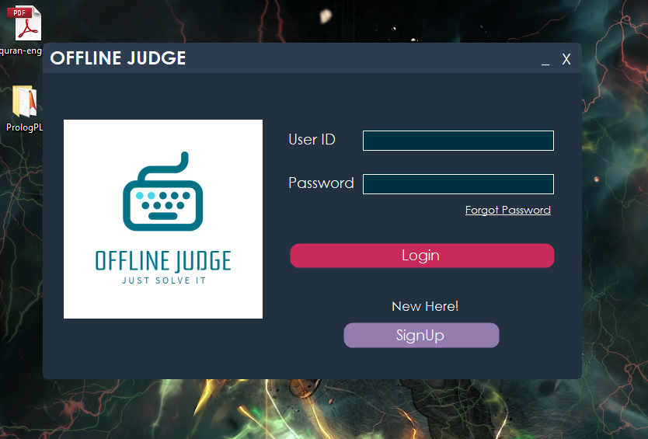
Login
Login Window
Containing Login &
Sign Up feature.
Forget Password option
Will send email to the
Data administrator when
Device is online

Slide 5
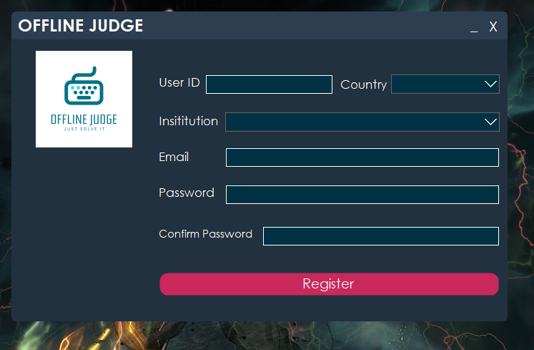
Sign Up
Sign Up button Pop up an
Sign up window that has
Some text and combo
Boxes. User id must contain
Both lower and upper case.
Password must contain
Upper ,lower, special , and
Numerical character. When
Password matches for both
Boxes, you are registered.

Slide 6
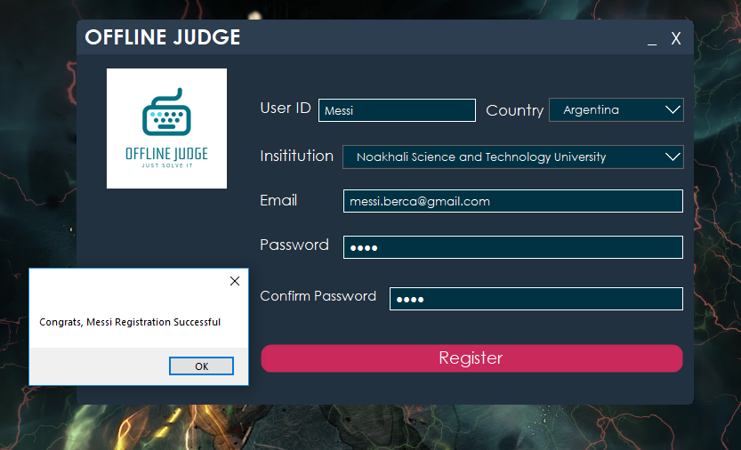
Registration Successful
After clicking the register button,
If all data seems right, a message
Box will be shown and the input
Data will be inserted into the
OJDB databse’s reg Table.
When registration is done the
Login window will appear again.

Slide 7
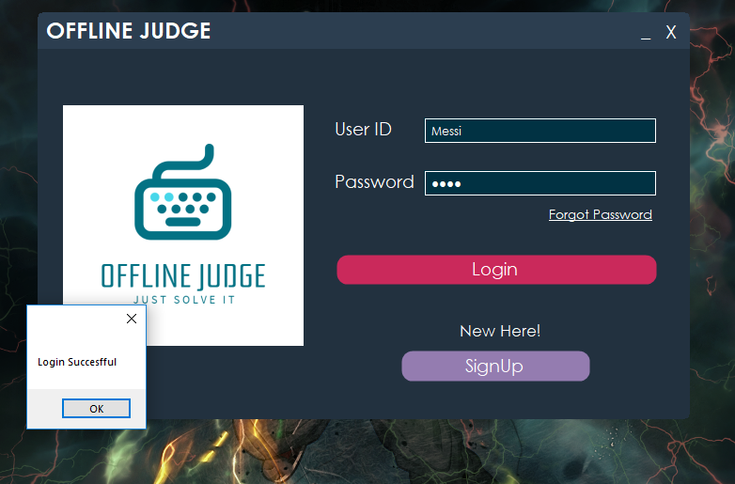
Login Successful
In login window, if the user id
and password row can be
Found on reg table, then the
Login will be successful. After
That the categories window
Will appear

Slide 8
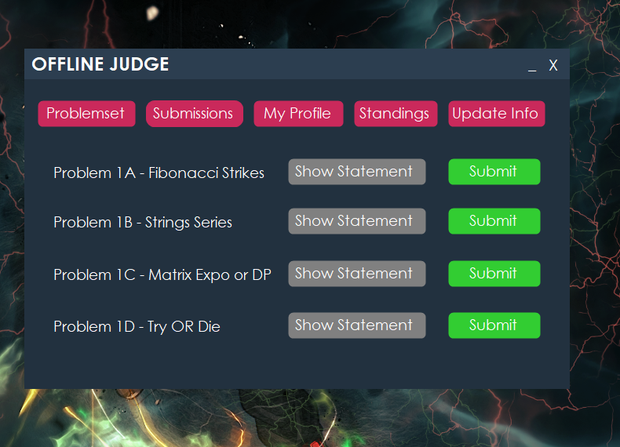
Homepage
This is the homepage. Five top
Menus are the basic features.

Slide 9
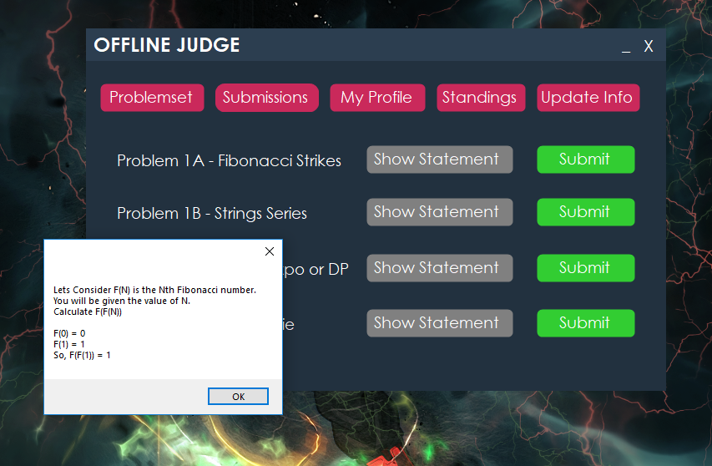
Statement
Show Statement button for
Each problem will show the
Description of problem in a
Message BOX.

Slide 10
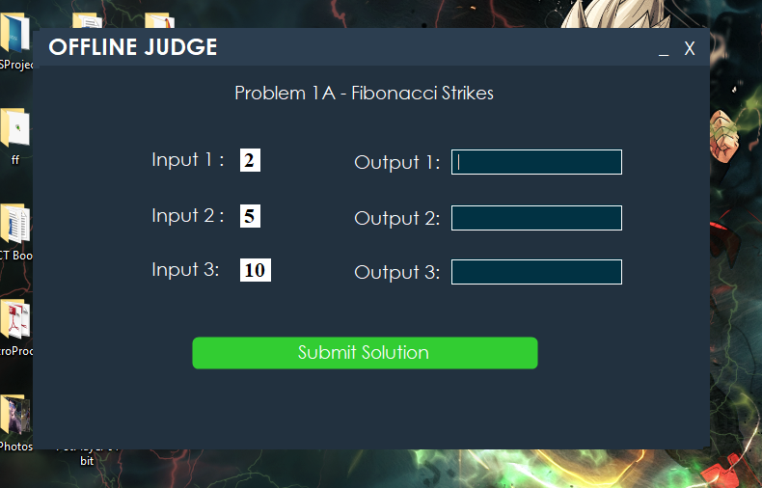
Cases
Here Random cases will
Appear for this problem.
User have to input the answer
For this case for given output

Slide 11
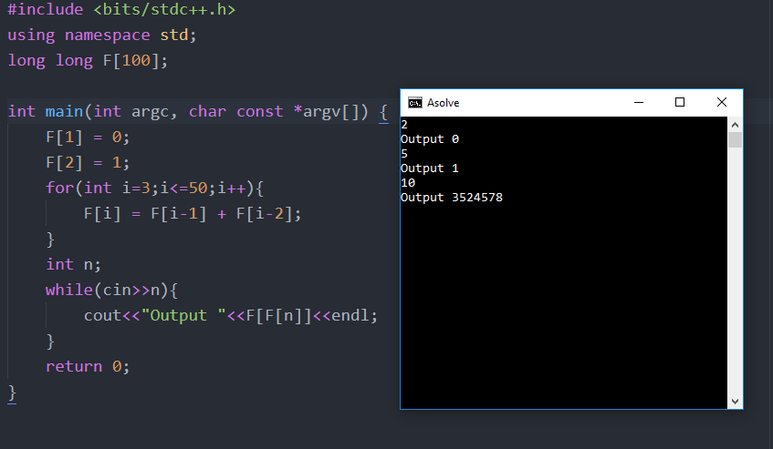
Coding
Use will get the outputs by
Solving the problem in any
Language he wants.

Slide 12
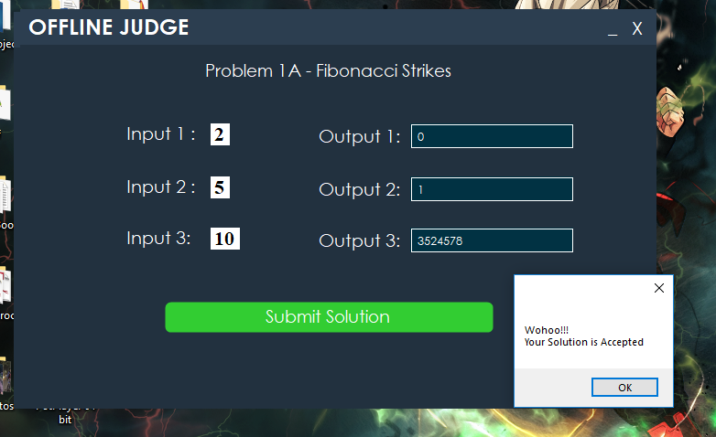
Verdict
Output will be checked.
If all are correct, Accepted
Verdict will be shown.

Slide 13
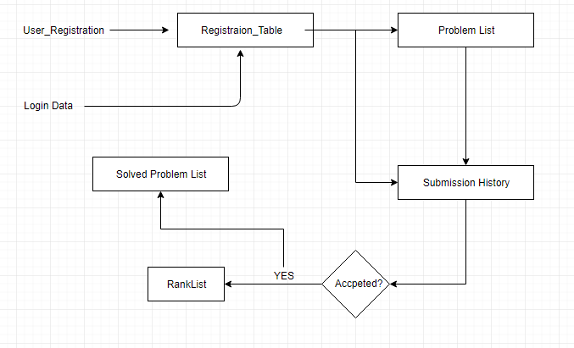
DFD
Five tables
Registration
Problem List
Submission History
Rank list (Avoidable)
Solved Problem List of
an user.

Slide 14
Thanks for you patience
Submitted By
Md. Alif Biswas
#1502060

